Slide 1


智冠科技 數位發展中心
Google Cloud Platform Tutorial
智冠科技

Slide 2
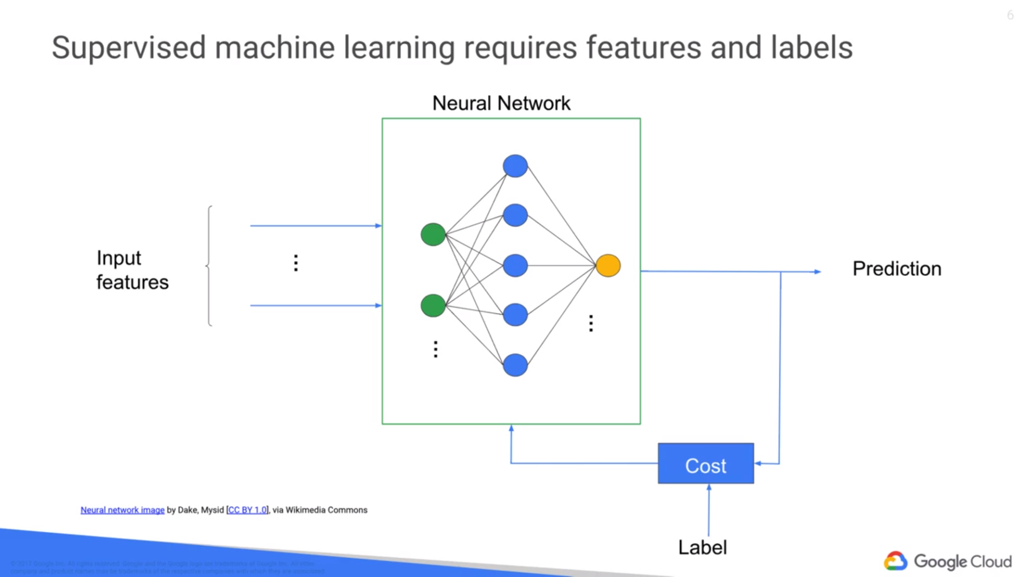
Neural Network
TensorFlow：Neural Network

Slide 3
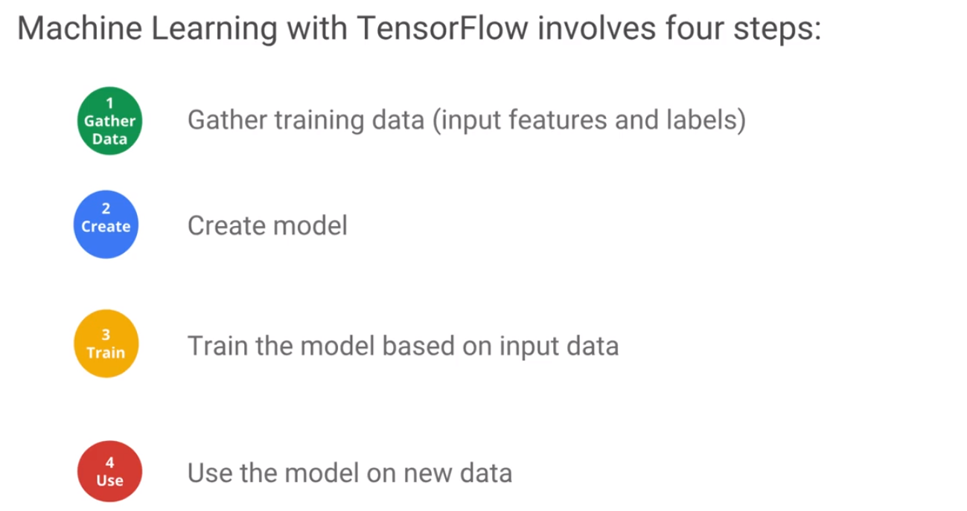
Neural Network
TensorFlow：Neural Network

Slide 4
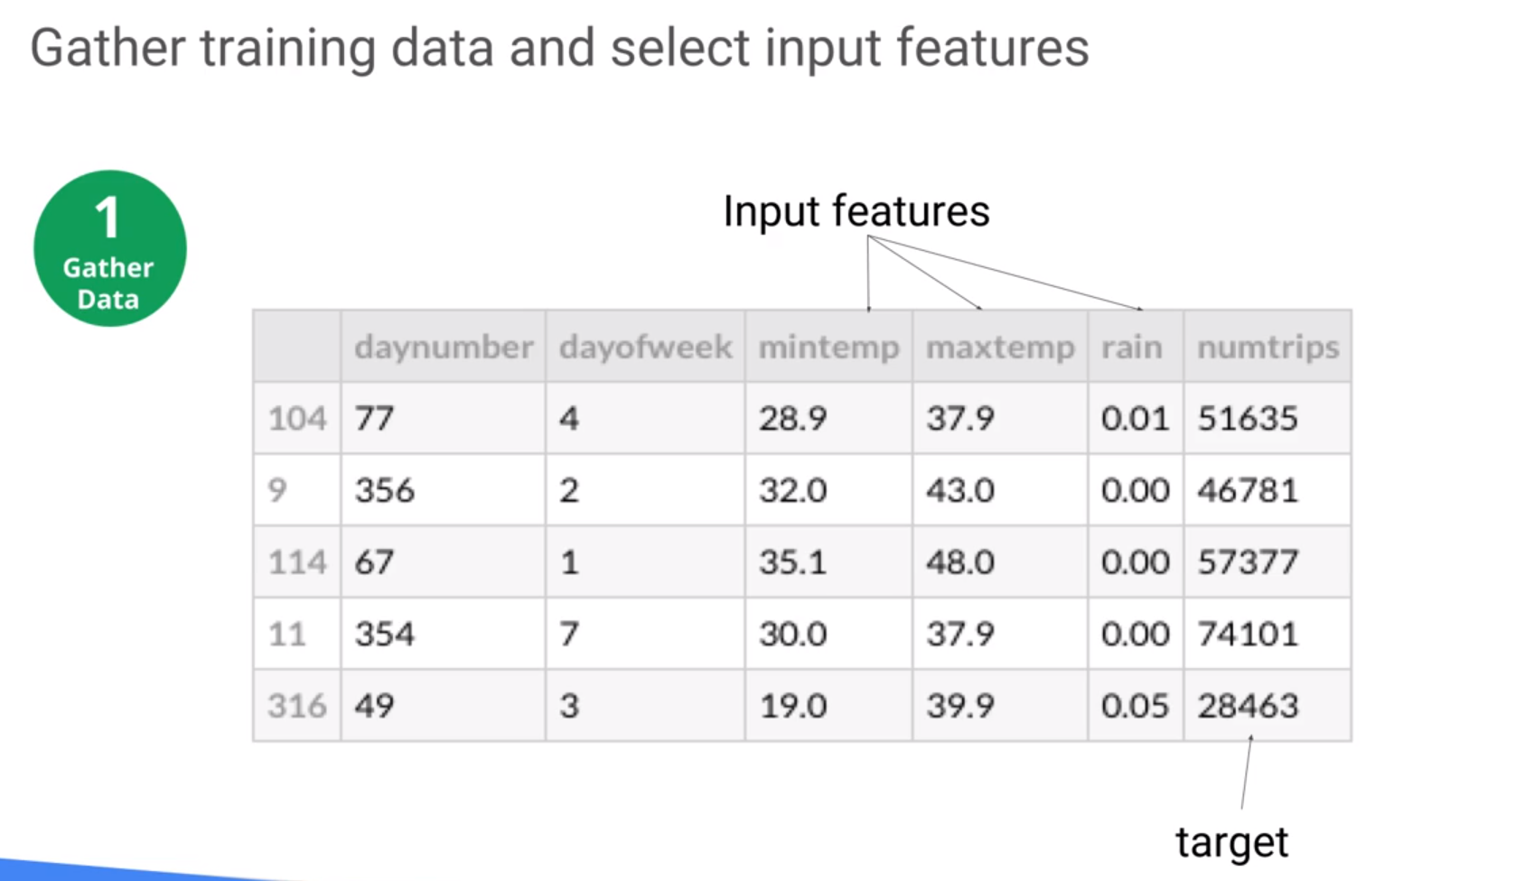
Neural Network
Neural Network
TensorFlow：Neural Network
Numeric data

Slide 5
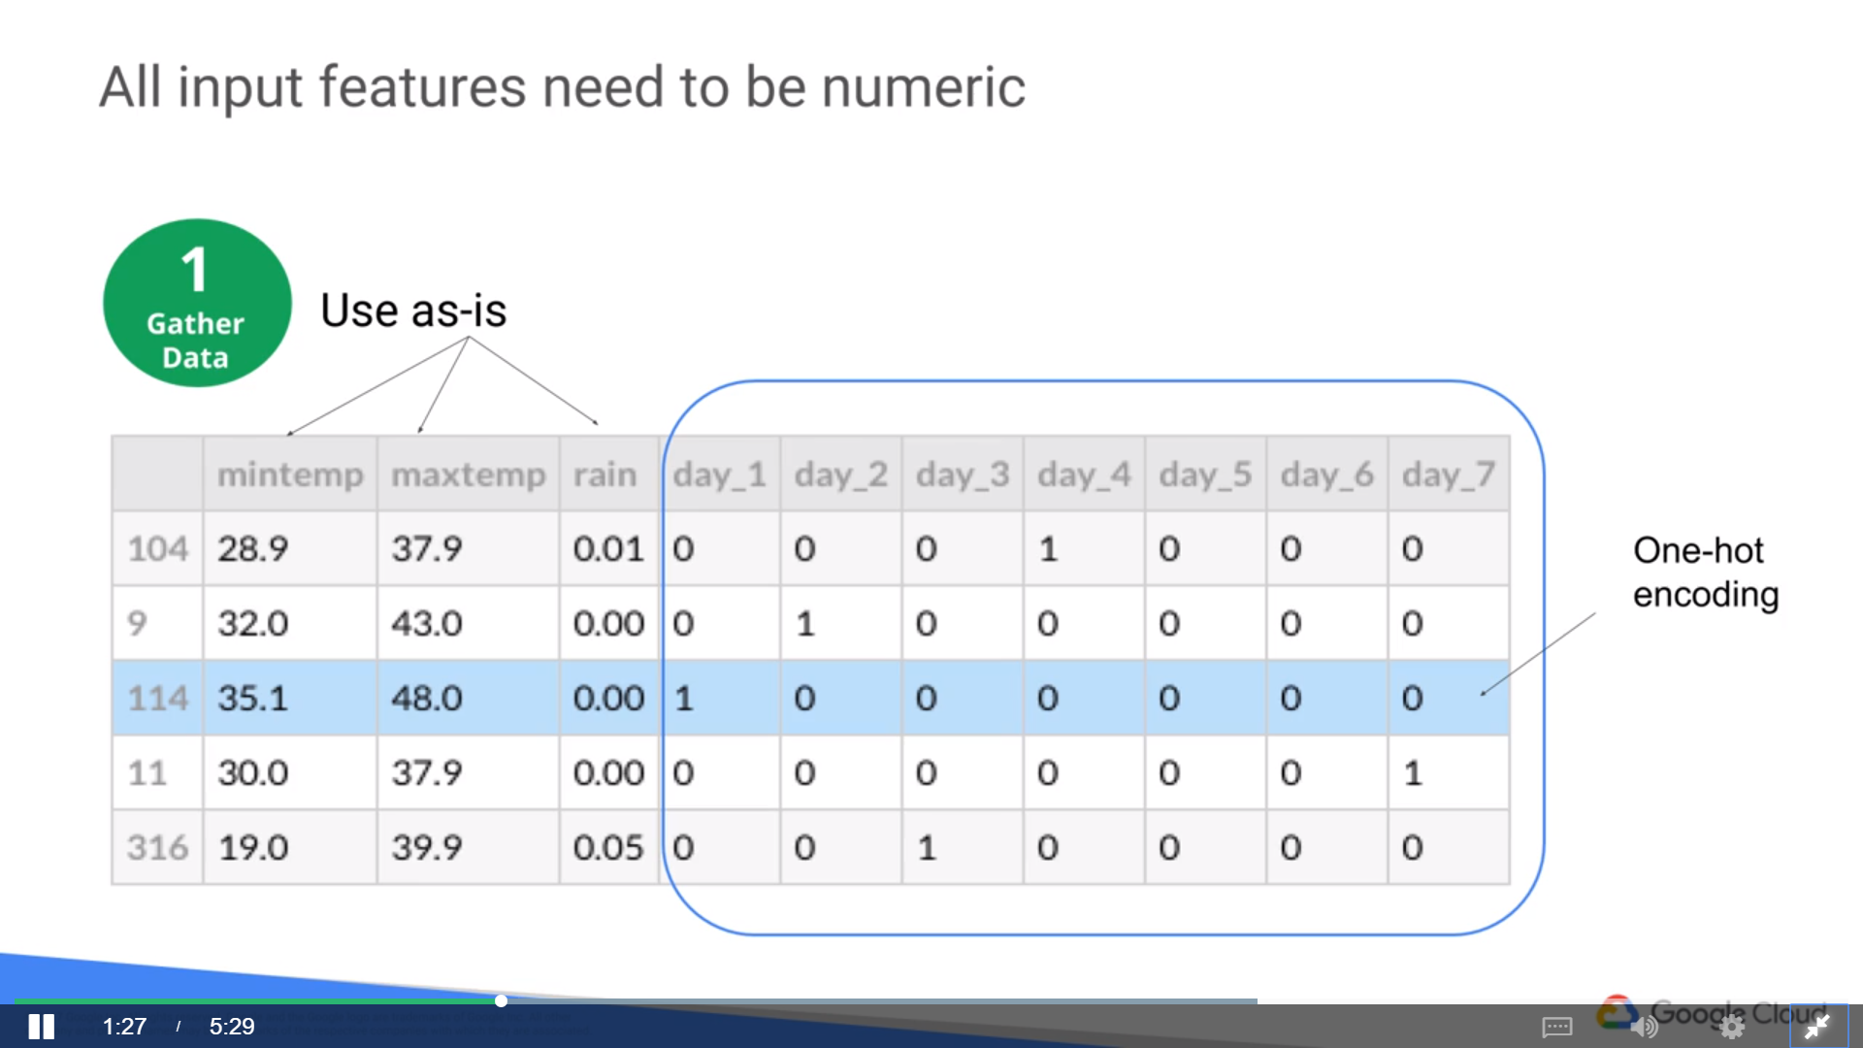
Neural Network
Neural Network
TensorFlow：Neural Network
get_dummies(data)

Slide 6
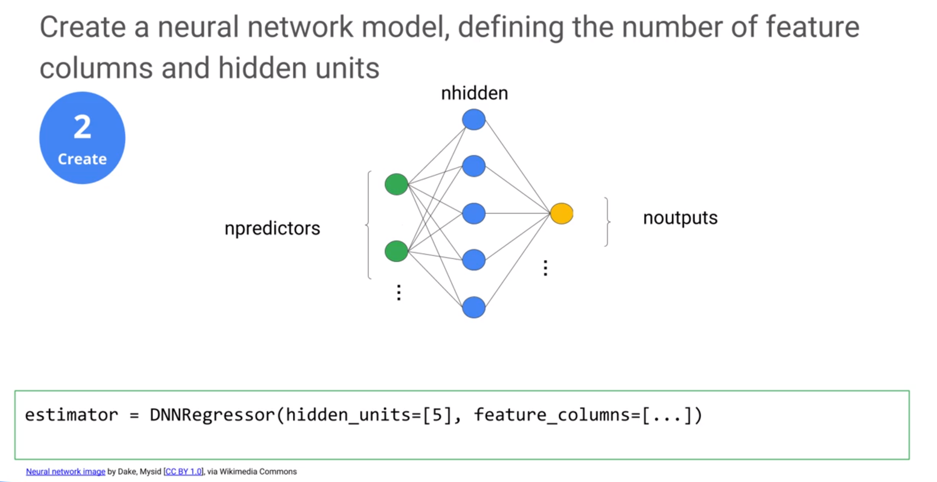
Neural Network
Neural Network
TensorFlow：Neural Network
get_dummies(data)

Slide 7
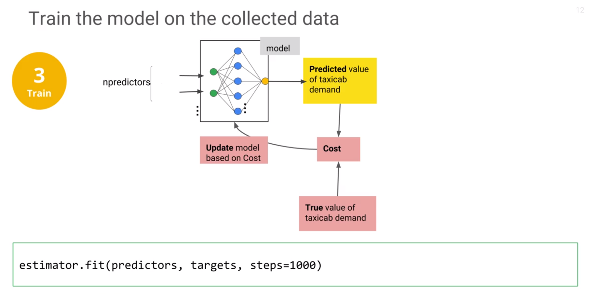
Neural Network
Neural Network
TensorFlow：Neural Network
get_dummies(data)

Slide 8
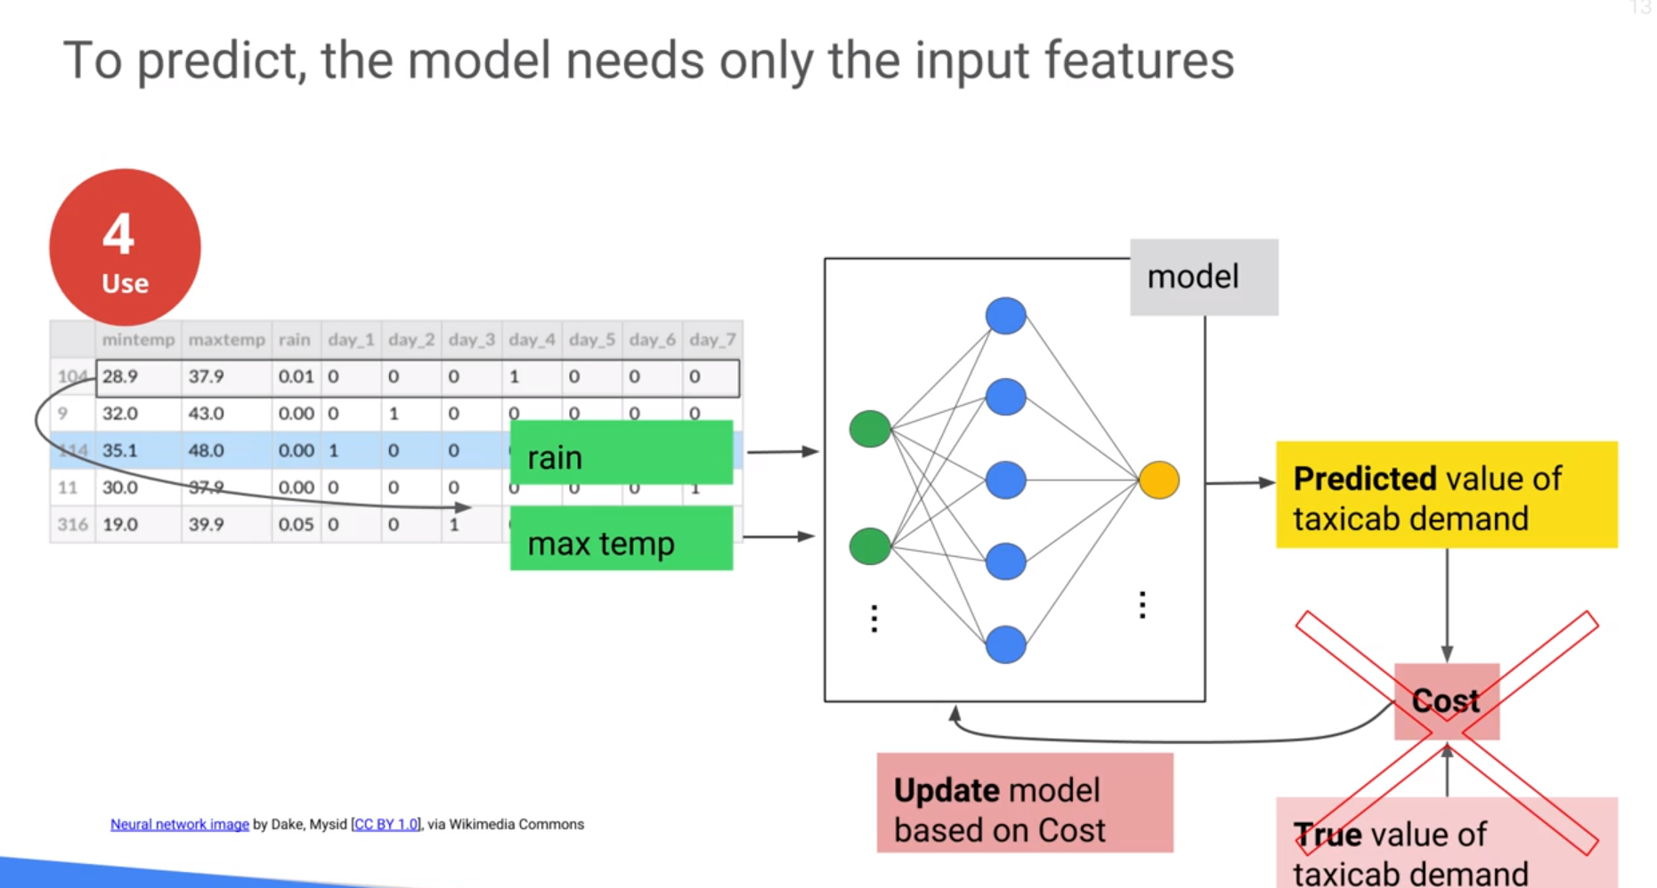
Neural Network
Neural Network
TensorFlow：Neural Network
get_dummies(data)

Slide 9
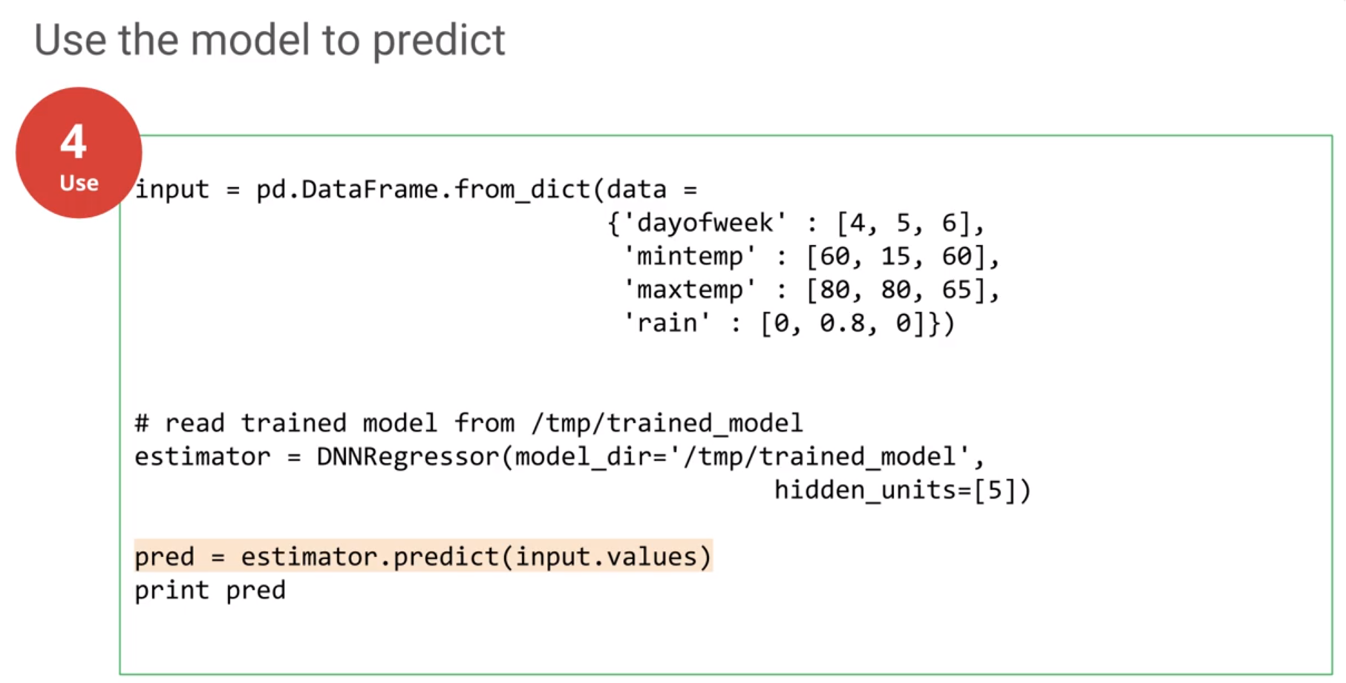
Neural Network
Neural Network
TensorFlow：Neural Network

Slide 10

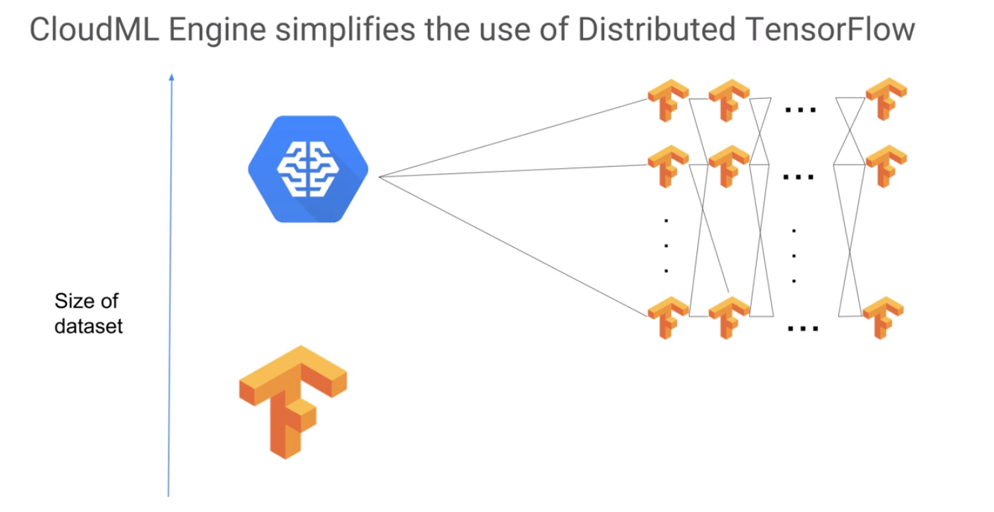
GCP, Step 3, Data Analysis: Cloud ML engine, prebuilt model

Slide 11
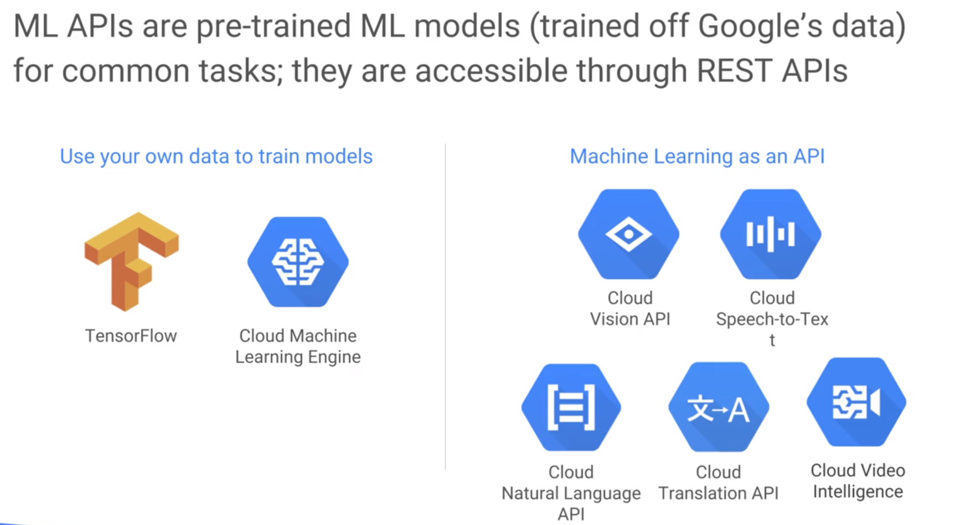
GCP, Step 3, Data Analysis: Cloud ML engine, prebuilt model

Slide 12
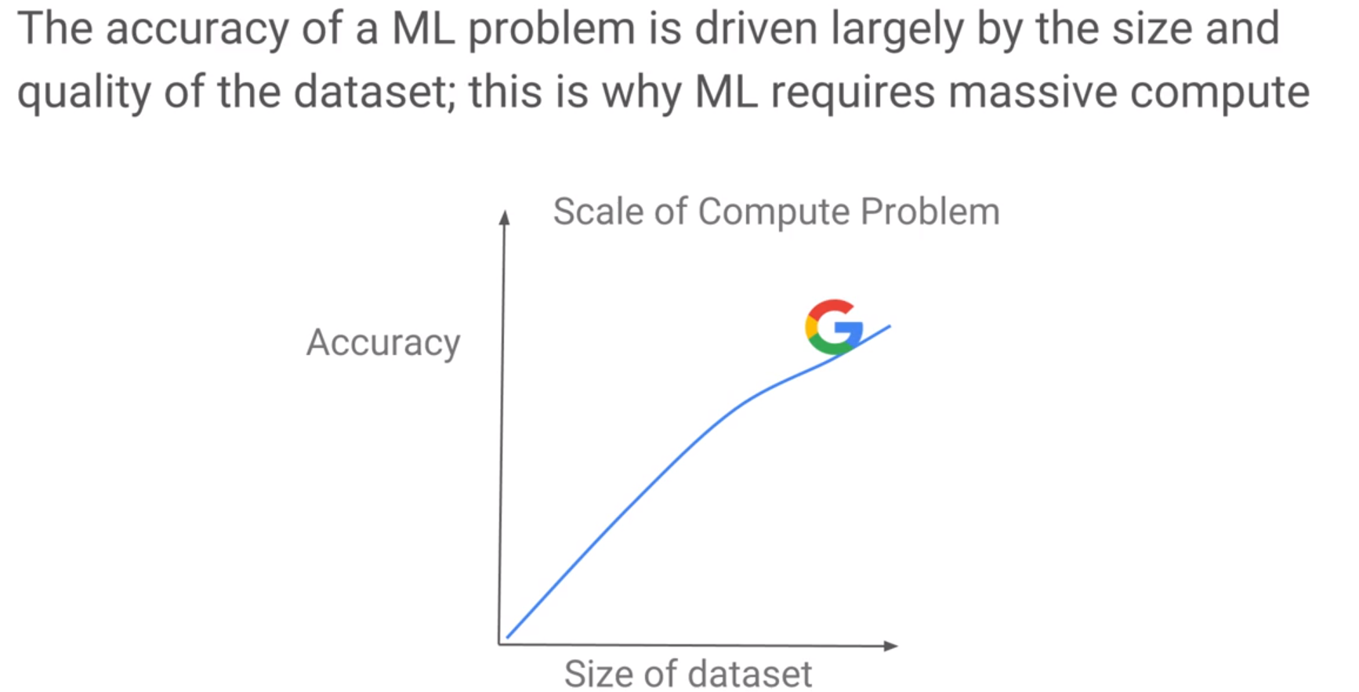
GCP, Step 3, Data Analysis: Cloud ML engine, prebuilt model
In terms of the amount of data, no one can defeat Google

Slide 13

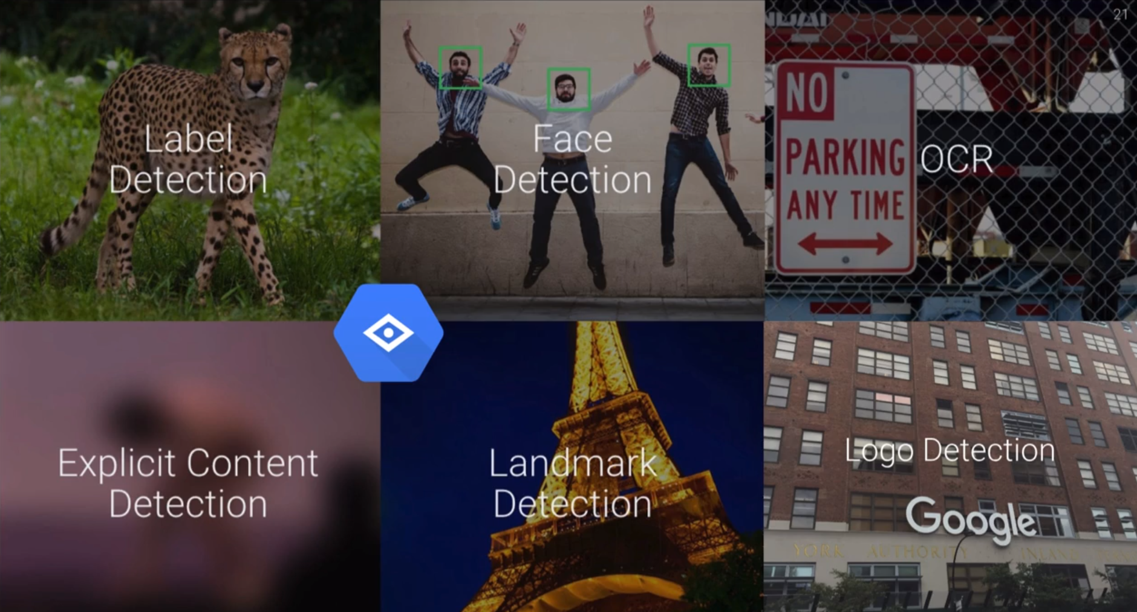
GCP, Step 3, Data Analysis: Cloud Vision API
Optical Character Recognition
Adult, Violent

Slide 14
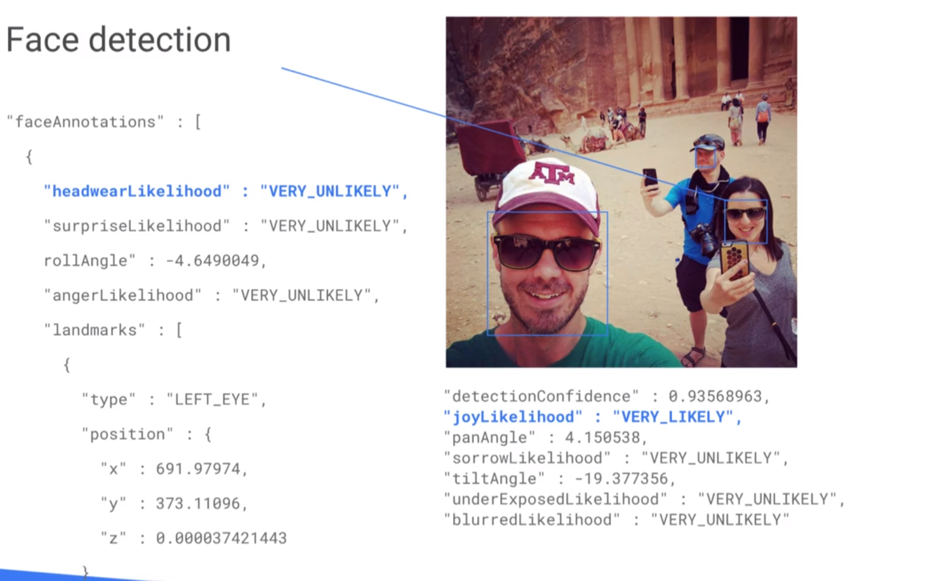
GCP, Step 3, Data Analysis: Cloud Vision API

Slide 15
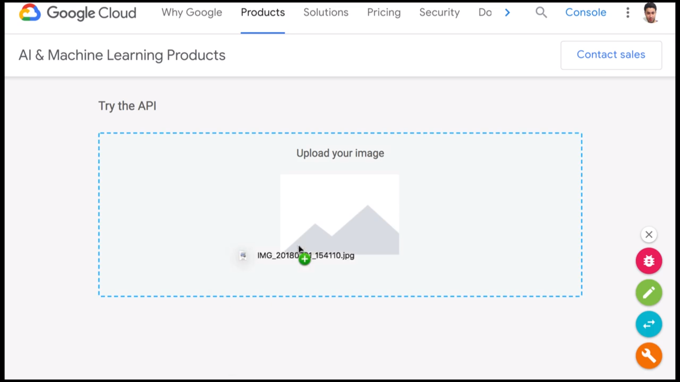
GCP, Step 3, Data Analysis: Cloud Vision API

Slide 16
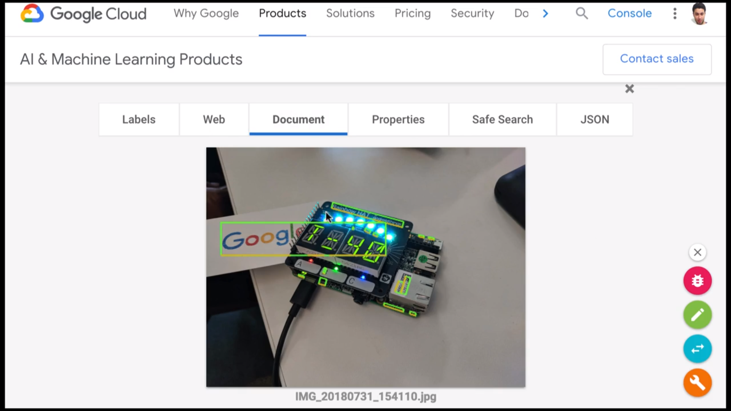
GCP, Step 3, Data Analysis: Cloud Vision API

Slide 17
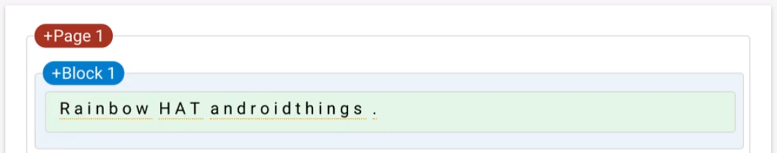
GCP, Step 3, Data Analysis: Cloud Vision API

Slide 18
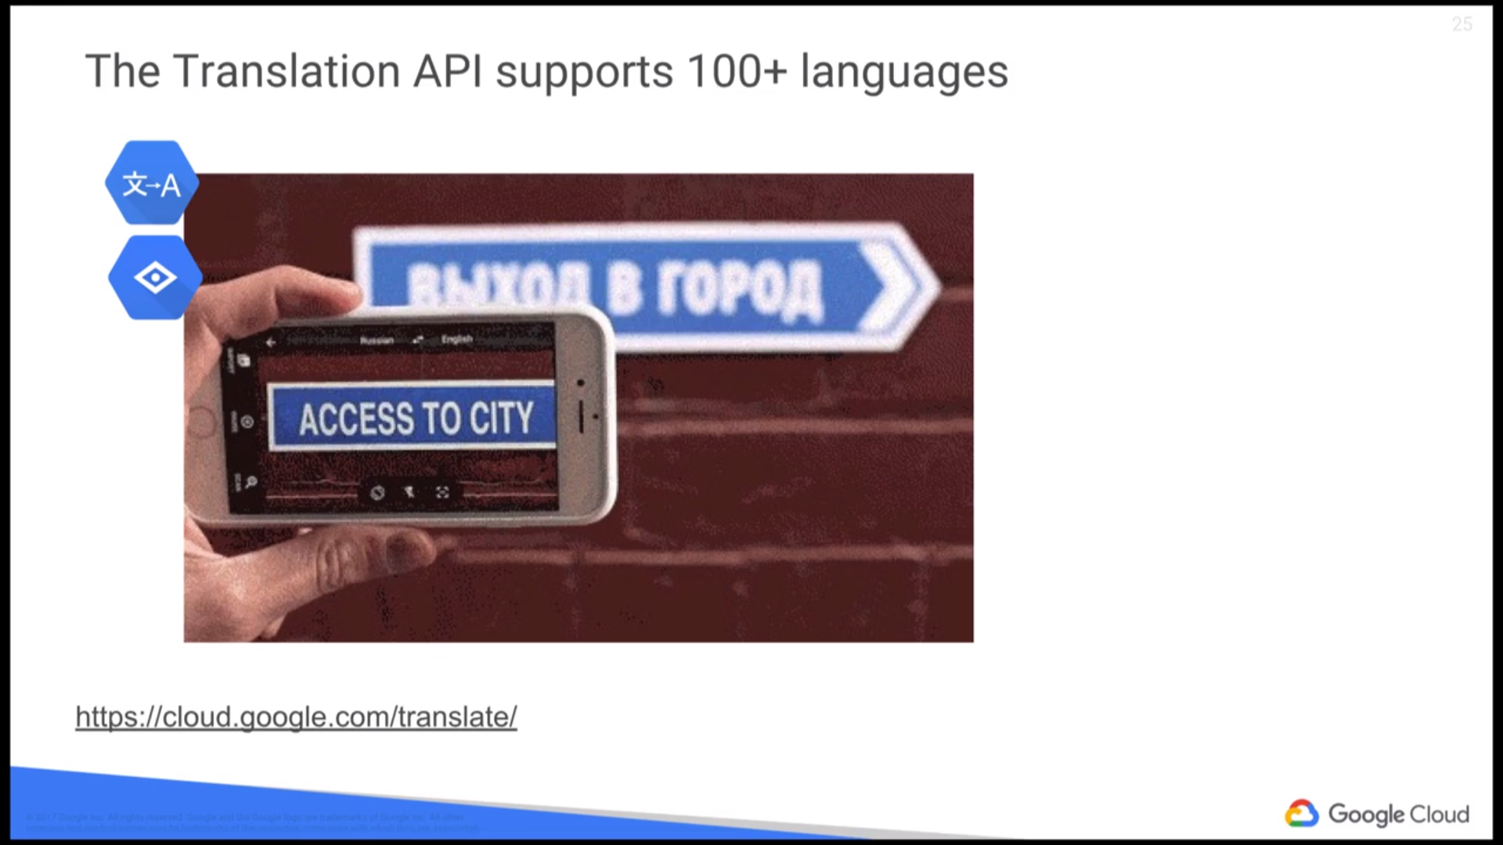
GCP, Step 3, Data Analysis: Cloud Vision API + Translation API

Slide 19

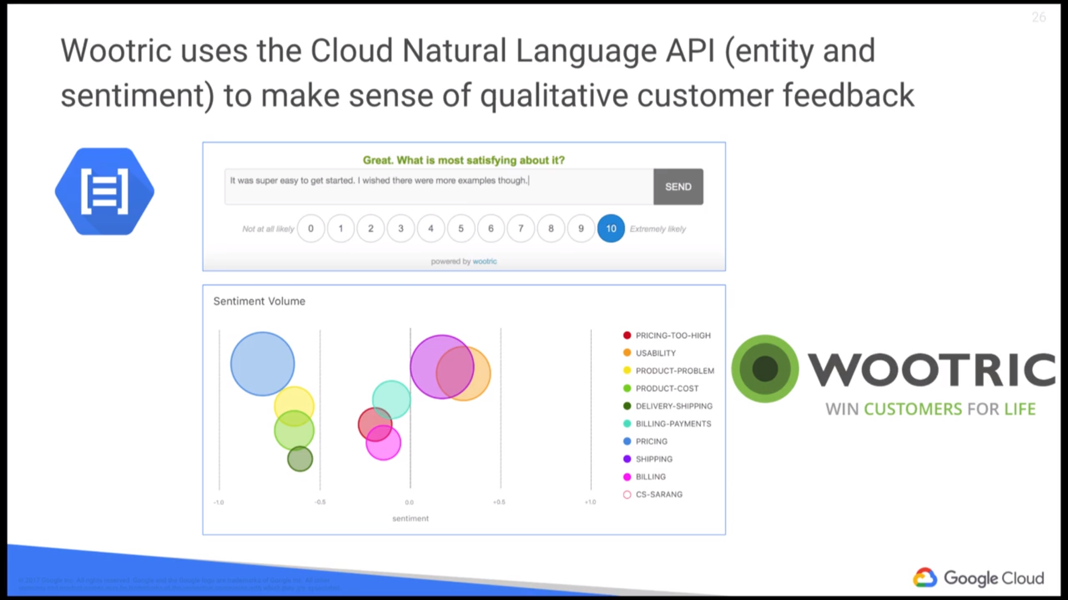
GCP, Step 3, Data Analysis: Cloud Natural Language API

Slide 20
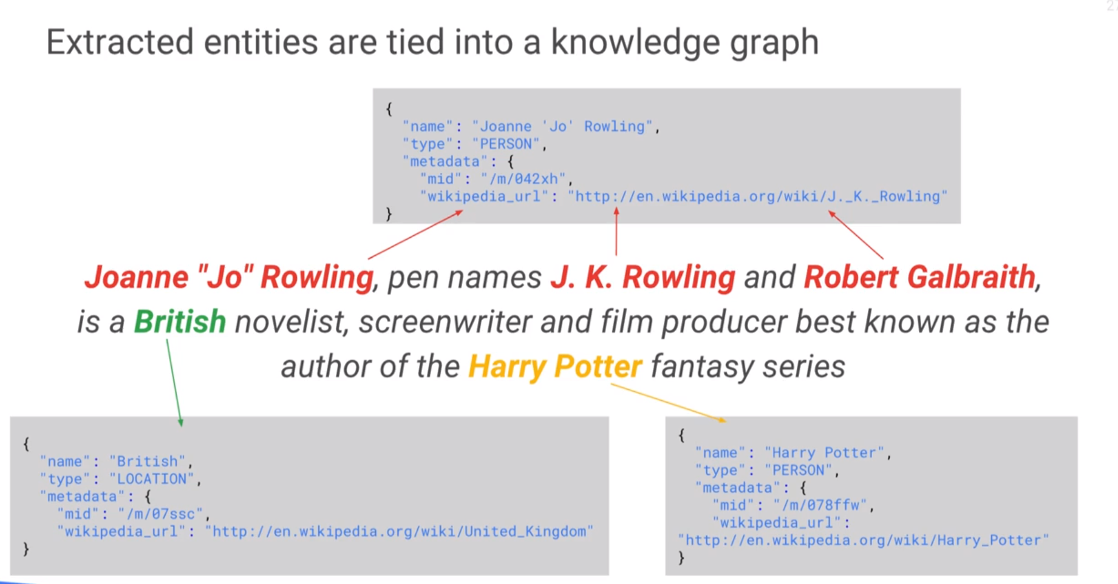
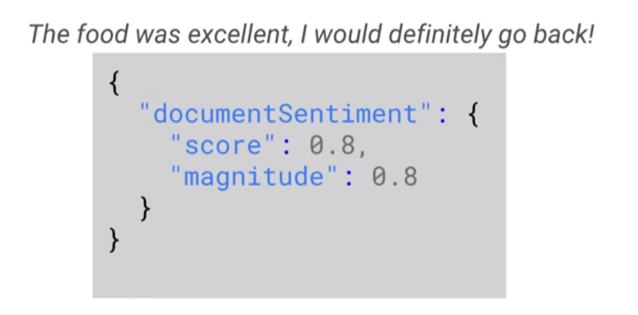
GCP, Step 3, Data Analysis: Cloud Natural Language API

Slide 21

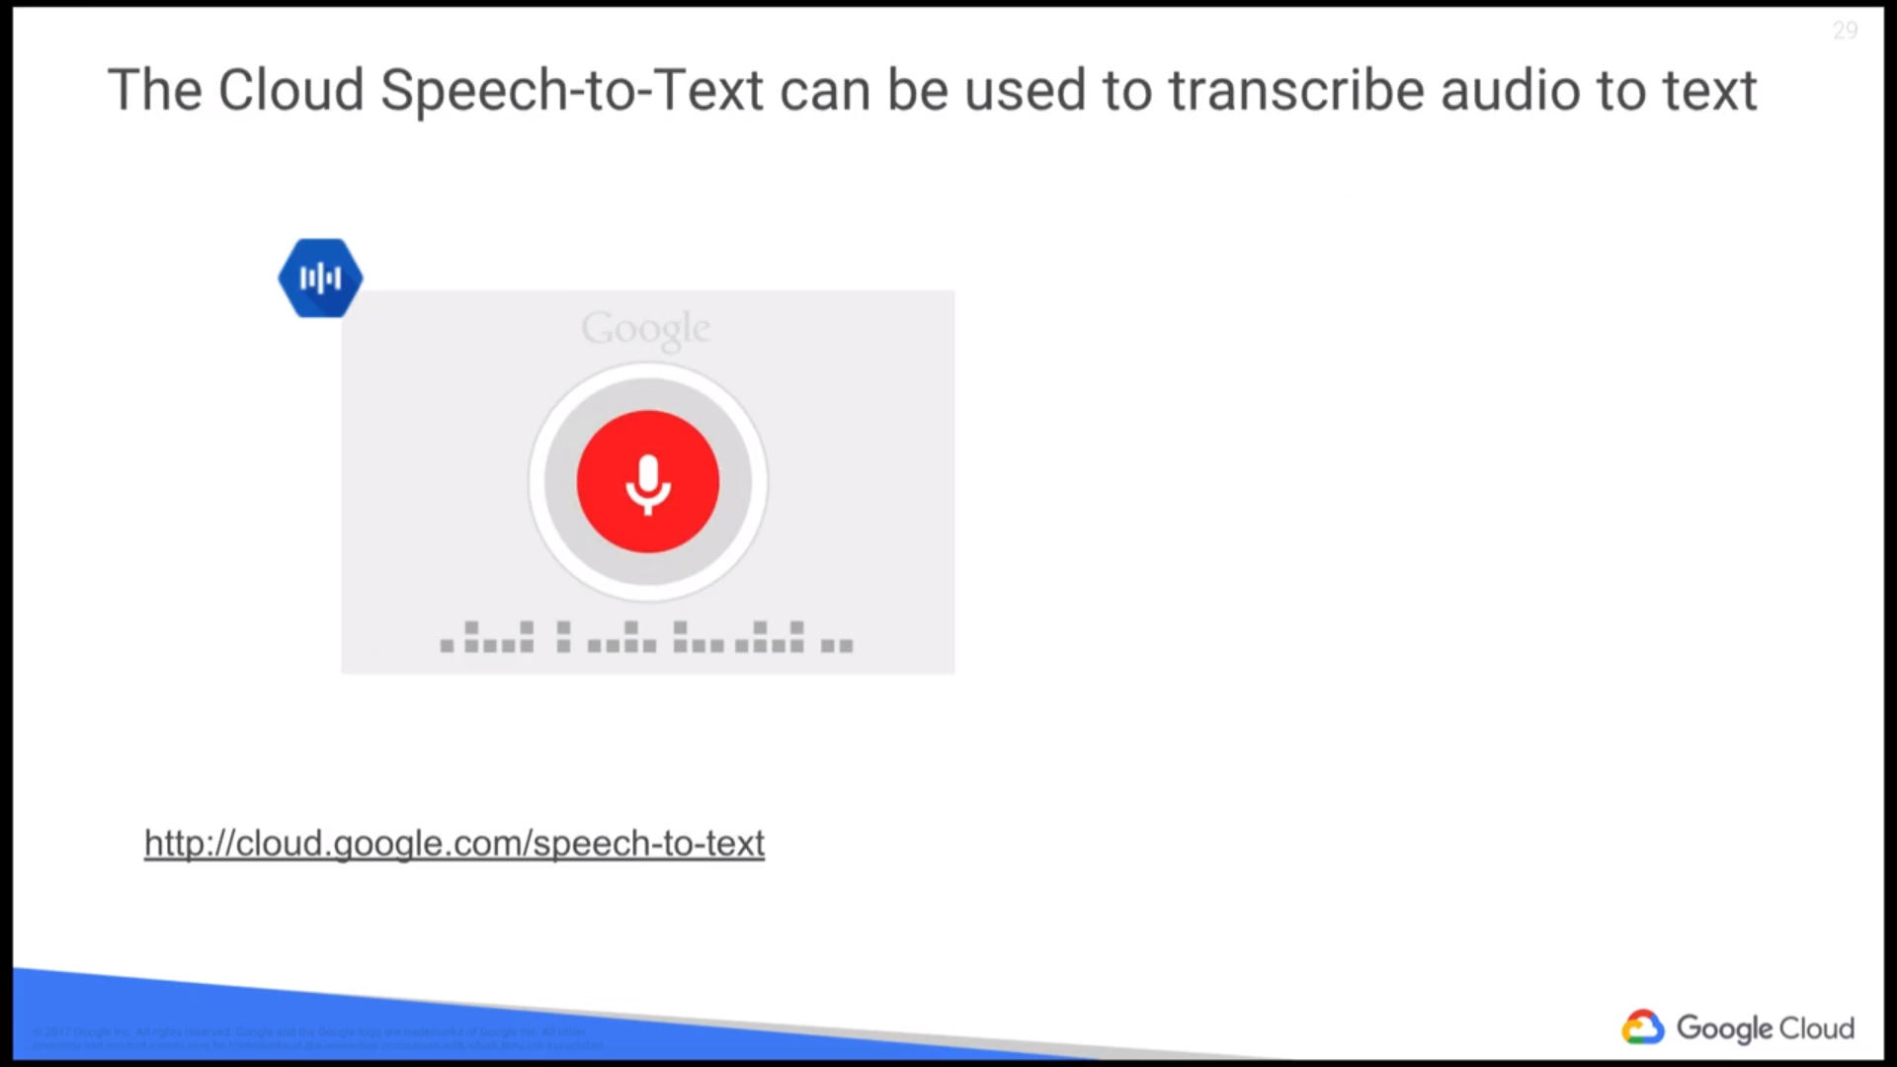
GCP, Step 3, Data Analysis: Cloud Speech-to-Text API

Slide 22

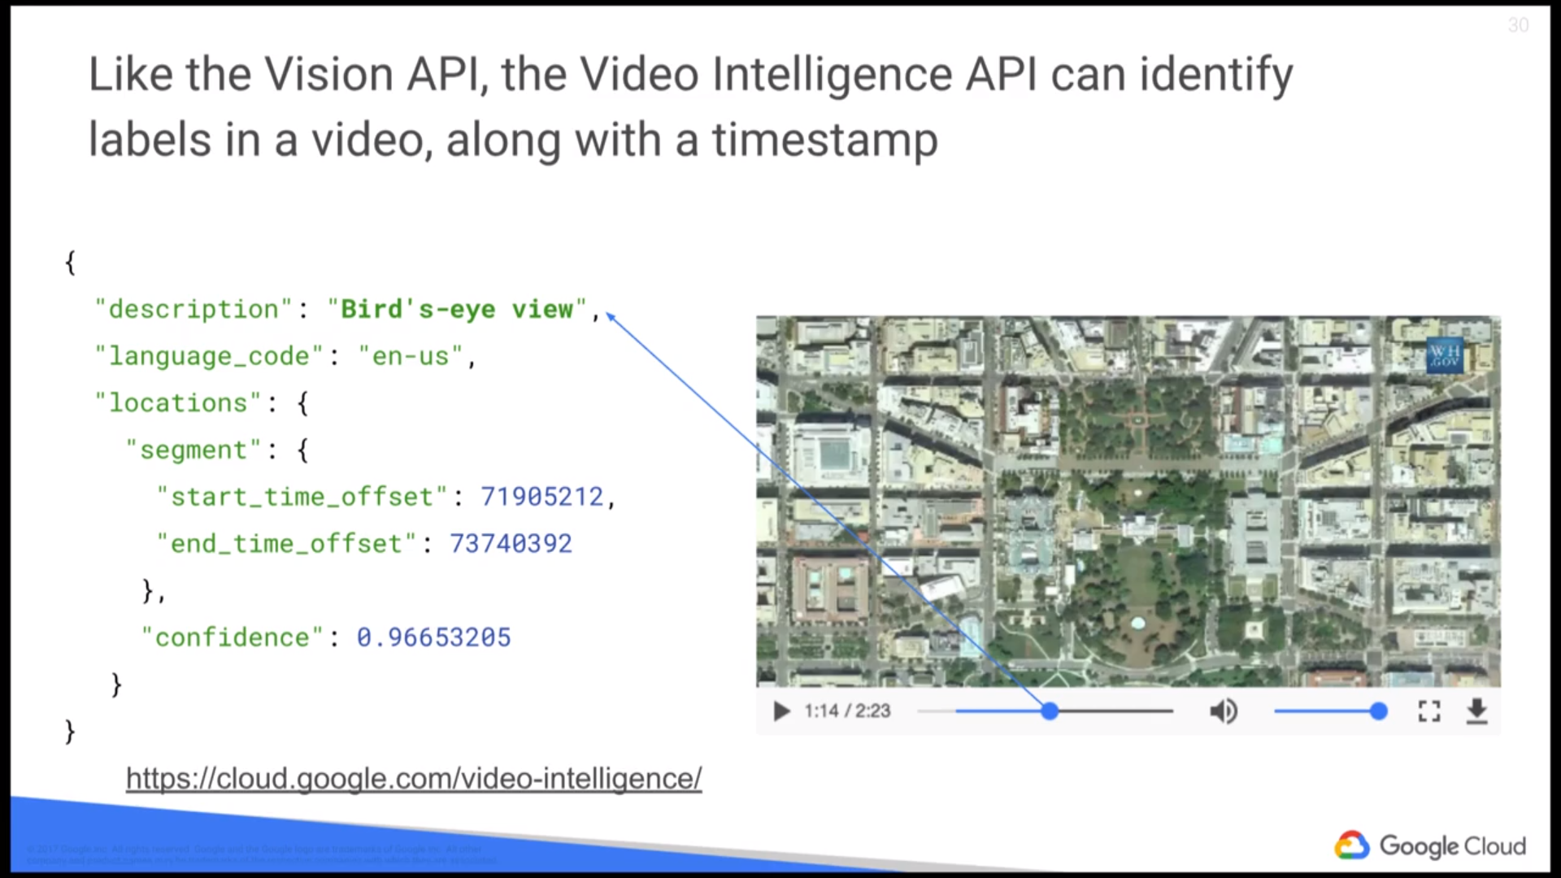
GCP, Step 3, Data Analysis: Cloud Video Intelligence

Slide 23
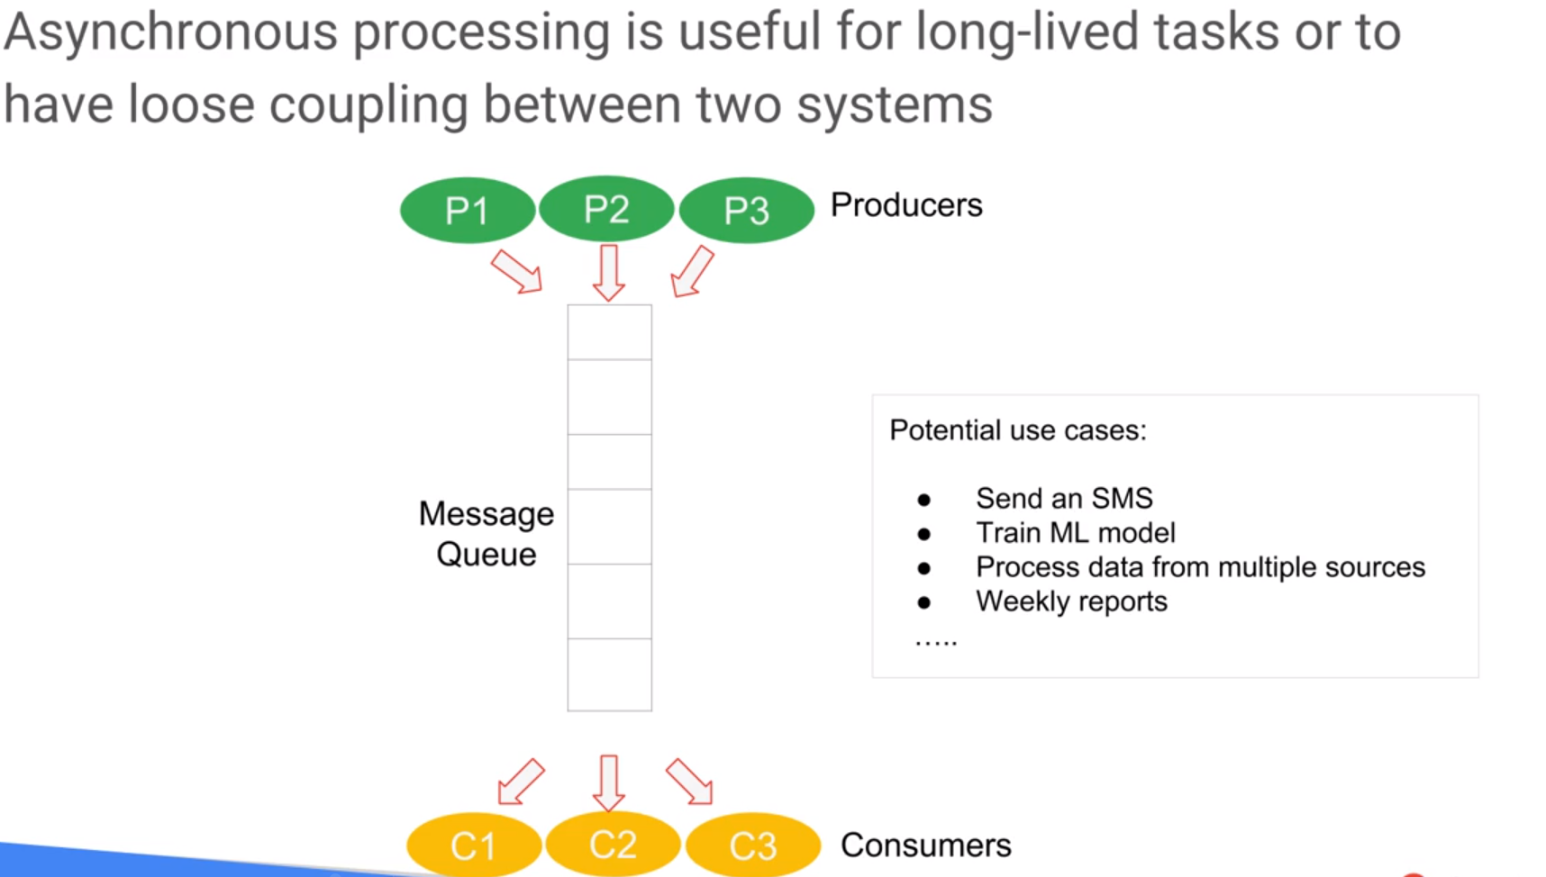
Message-Oriented Architectures
Data Processing Architectures
Rather than give response immediately Receive code will be given and process them separately
HA →asynchronous processing *load balance, balance high throughput *reduce coupling

Slide 24

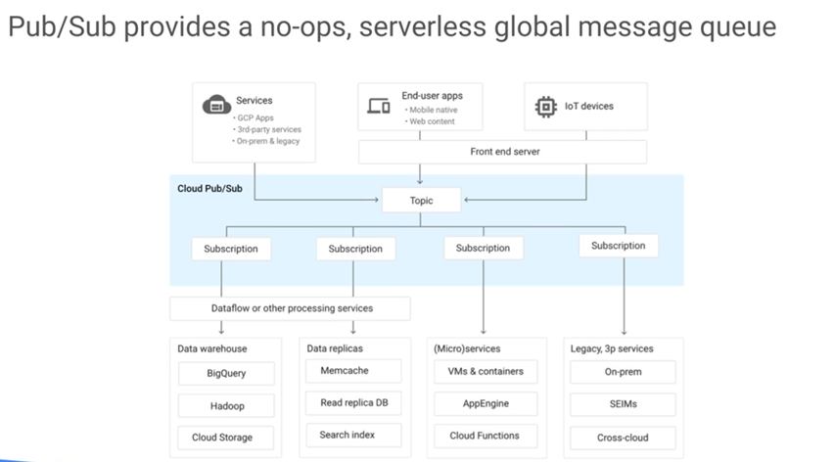
GCP, Step 0, Data Flow Pub/Sub
Message-Oriented Architectures
Reliable real time messaging accessed by GCP for multiple customer/subscription
Pub/Sub is a good to handle asynchronous processing

Slide 25

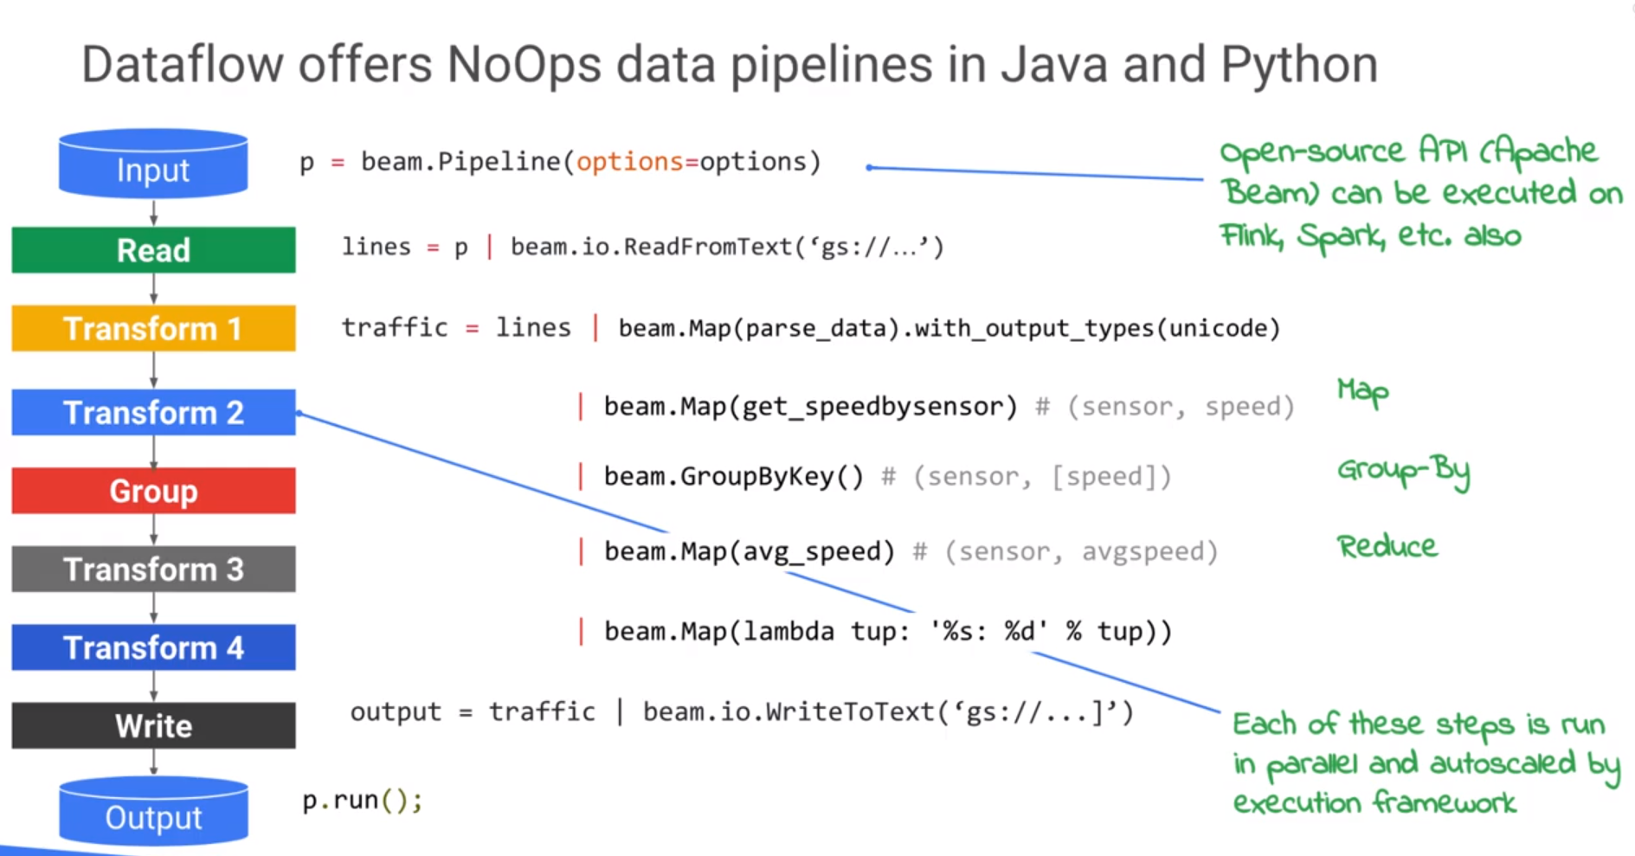
GCP, Step 0, DataFlow DataFlow
Manage parallel NoOps data ready for processing, autoscaled

Slide 26
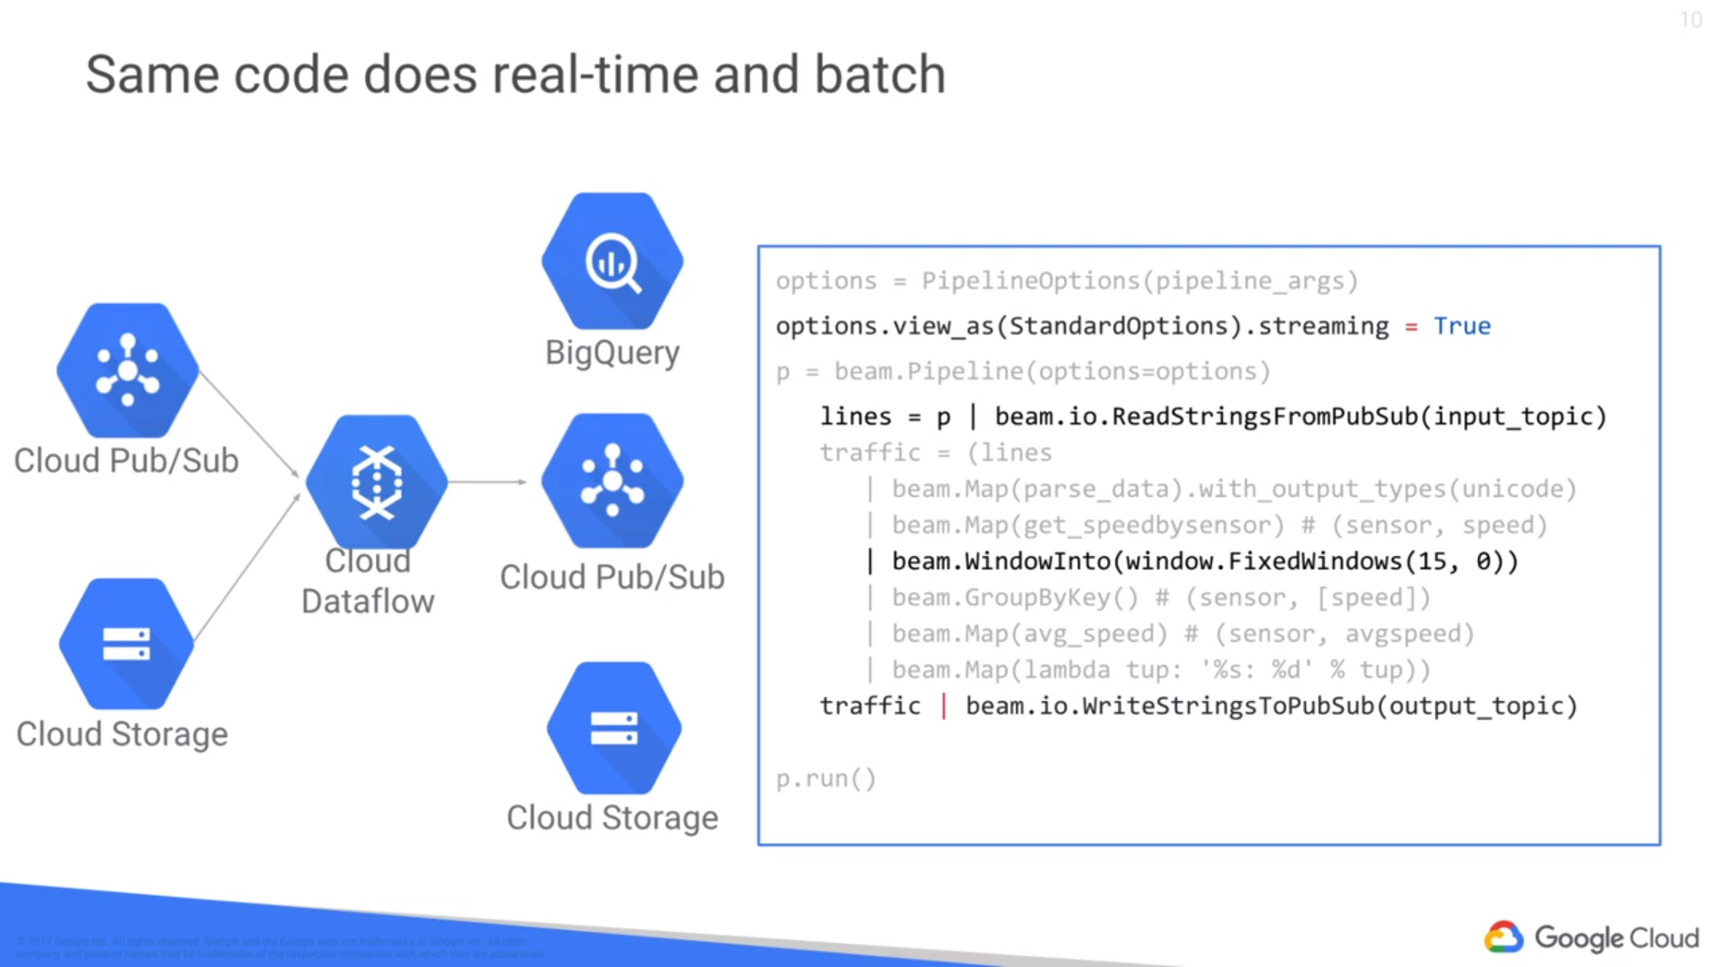
GCP, Step 0, Data Flow DataFlow

Slide 27
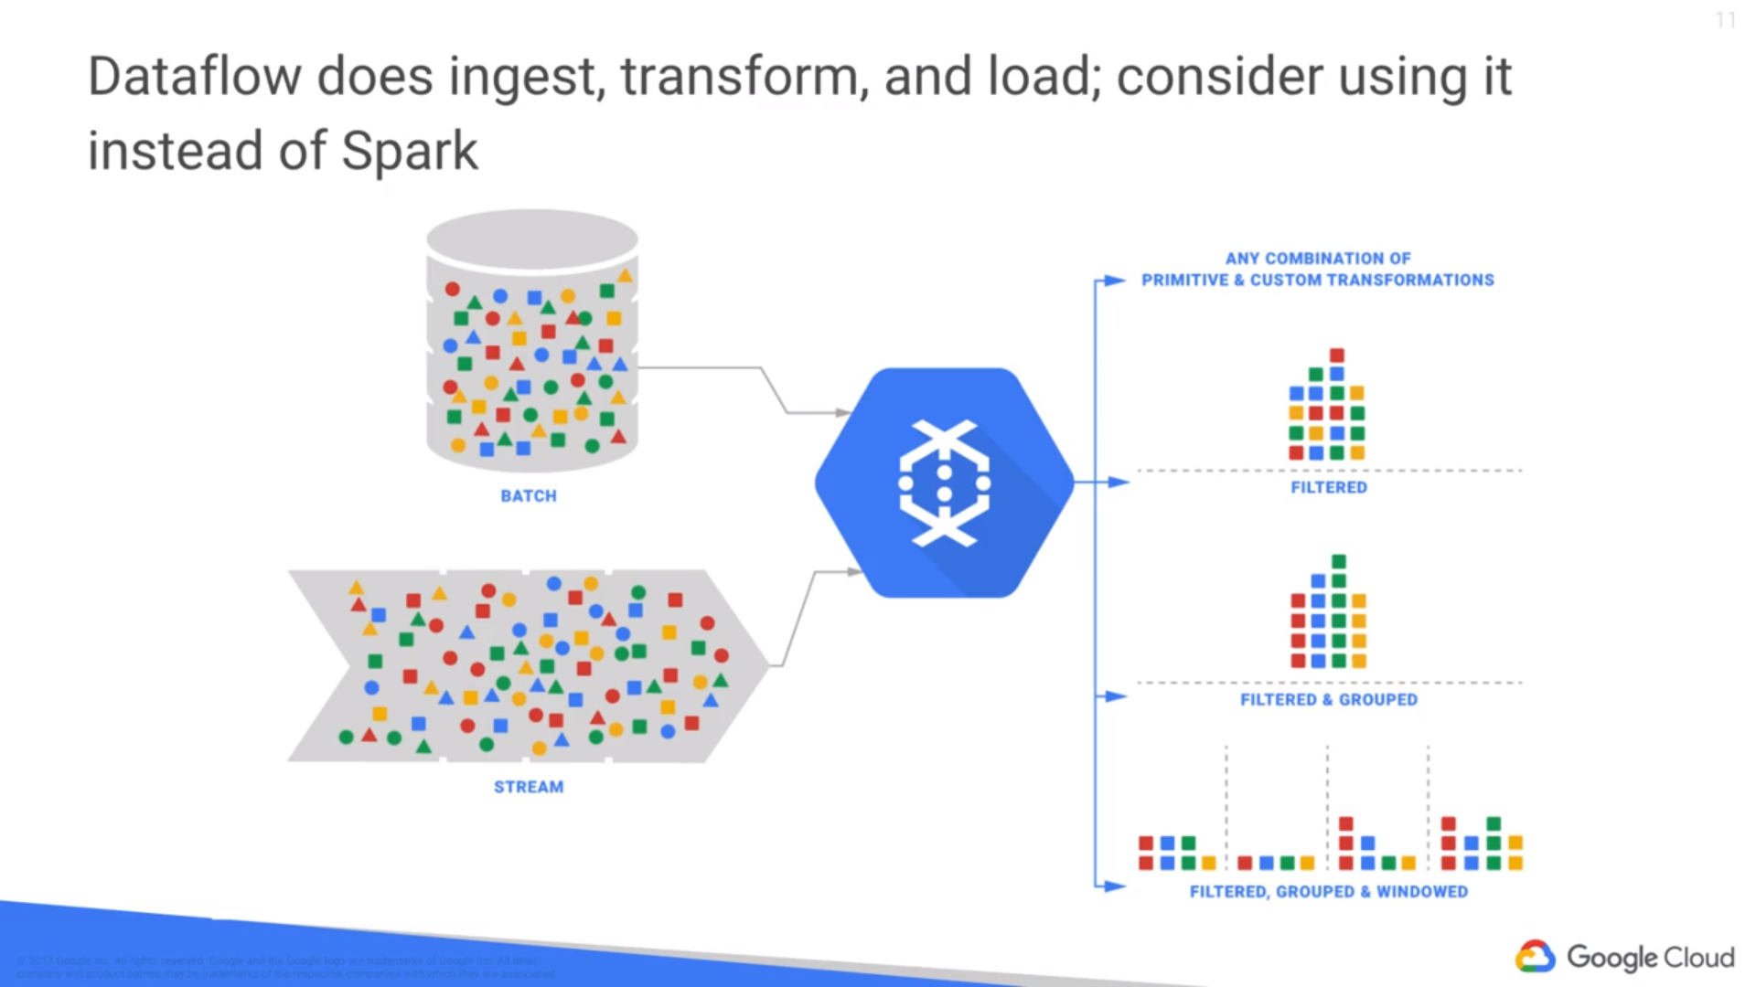
GCP, Step 0, Data Flow DataFlow
dataflow is where we see a lot of data pipelines migrating because you want to process historical data and real-time data in an identical way.
Dataflow is the essential glue in order to be able to do data processing.

Slide 28
GCP, Step 0, Data Flow Pub/Sub vs DataFlow
PubSub：Decoupling producer and consumer of data in large organizations and complex systems
DataFlow：Scalable, fault-tolerant mutil-step processing of data

Slide 29
